Slide 1





Vidyavardhini’s College of Engineering & Technology
Department of Artificial Intelligence & Data Science
VR In Gaming
By:
Paritosh Khanwe
Roll No - 72
Department of Computer science (Data Science)
Vidyavardhini’s College of Engineering and Technology

Slide 2
Introduction
Virtual Reality (VR) refers to a computer-generated simulation of an immersive, three-dimensional environment .
VR in gaming offers a revolutionary way to play and experience video games
Display an engaging image of someone wearing a VR headset, fully immersed in a virtual gaming environment. This image should help convey the idea of the immersive experience VR provides in gaming.

Slide 3
Brief Overview Of VR In Gaming
Virtual Reality (VR) in gaming represents a transformative leap in how we play and experience video games.
VR technology creates a simulated, three-dimensional environment that immerses players into a digital world.
VR in gaming stands for Virtual Reality, offering an immersive digital experience.
It transports players into a computer-generated 3D world.
VR is revolutionizing the gaming industry by providing unique experiences.
It is a rapidly evolving technology with vast potential for the future of gaming.

Slide 4
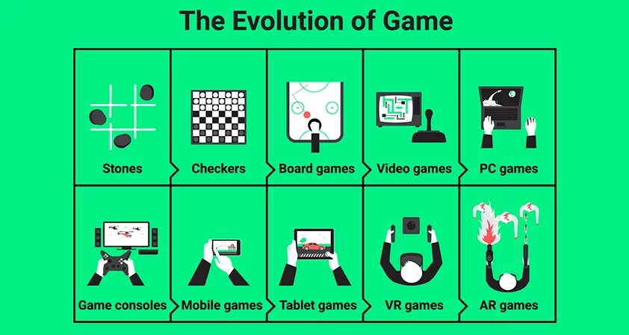
Evolution Of Gaming

Slide 5
Timeline Of Gaming
Also in 1989, Sega released its 16-bit Genesis console in North America as a successor to its 1986 Sega Master System, which failed to adequately compete against the NES.
In the mid-1990s, video games leaped to the Big Screen with the release of the Super Mario Bros
In 2005 and 2006, Microsoft’s Xbox 360, Sony’s Playstation 3, and Nintendo’s Wii kicked off the modern age of high-definition gaming.
The Xbox 360, which had similar graphics capabilities to the Playstation 3, was lauded for its online gaming ecosystem and won far more Game Critics Awards than the other platforms in 2007
Angry Birds Maker Rovio Reports $200 Million In Revenue, $71 Million In Profit For 2012

Slide 6
Applications
Immersive experience
Realistic graphics and sound
Interactivity and presence
Image: Side-by-side comparison of traditional gaming vs. VR gaming

Slide 7
Popular VR Games
Star Wars: Squadrons: A space combat game set in the Star Wars universe, offering thrilling dogfights and starfighter piloting.
Resident Evil 7: Biohazard: A survival horror game that immerses players in the terrifying world of Resident Evil in VR.
VR Worlds: A collection of mini-games and experiences designed to showcase the capabilities of VR technology.

Slide 8
Advantages
Realistic Graphics and Sound:VR technology delivers lifelike graphics and 3D spatial audio, creating a more convincing and sensory-rich gaming experience.
Interactivity:VR headsets and controllers allow for natural and intuitive interactions with the virtual world.
Physical Engagement:Many VR games encourage physical movement and activity, promoting a healthier and more active gaming experience.
Unique Game Experiences:VR opens up new possibilities for game genres and experiences not possible in traditional gaming.

Slide 9
Conclusion
In this presentation, we've explored the world of Virtual Reality (VR) in gaming. We defined VR as a technology that immerses players in computer-generated 3D environments using specialized hardware. We highlighted its relevance in gaming, showcasing its ability to provide an immersive experience, realistic graphics and sound, interactivity, and emotional engagement.

Slide 10
Thank You!

